Slide 1

If you move from LA to Nashville, which neighborhood might you want to live in?
Coursera Capstone Project for IBM Data Science Professional Qualification
By Meriel O’Conor
November 2019

Slide 2
Introduction
If you move from LA to Nashville, which neighborhood might you want to live in?
Problem:
Journalist/blogger wanting to give people information to help them make choices.
The end user would be someone moving from LA to Nashville.
Target audience:

Slide 3
Background on problem
I live in Nashville and there are lots of people relocating from LA to Nashville.
Some common themes for moving seem to be for more affordable housing, to escape the traffic and enjoy the vibrant music scene.
When you first arrive it can be hard to work out which area to live in.
This project aims to identify the most closely paralleled neighborhoods between LA and Nashville in order to suggest where new people might want to look for accommodation.
Using Foursquare data about which businesses and amenities are in each neighborhood I hope to find areas which have a similar mixture.
Then adding house price data to see how affordable the equivalent neighborhood is.

Slide 4
Data
The data sources for this project were:
Foursquare data https://foursquare.com/
Zillow data https://www.zillow.com/research/data/
The names of neighborhoods in LA were scraped from http://www.laalmanac.com/communications/cm02a90001-90899.php
The names of Nashville neighborhoods were extracted from https://nestinginnashville.com/buying-a-home-in-nashville/zip-code-map/

Slide 5

Methodology
Data on LA neighborhoods was parsed using BeautifulSoup4
Zip codes that were later discovered to have little value, including PO Boxes, where retroactively removed
Latitudes and Longitudes of each neighborhood were imported using pgeocode
LA neighborhoods were mapped using Folium
LA venues were extracted using the Foursquare API
The venue information was one hot encoded
A dendrogram was produced by creating a linkage matrix using scipy’s cluster package

Slide 6
Methodology
The Nashville neighborhood data was extracted
This data was edited in excel and reuploaded as an array which was then converted to a data frame
Steps 3-7 were then repeated for the Nashville data
The one hot encoded tables for LA and Nashville were joined
A combined dendrogram for LA and Nashville was created
House price data was extracted from Zillow and saved as a CSV
The CSV was uploaded and combined with the geographical data
Median house price by neighborhood was plotted

Slide 7
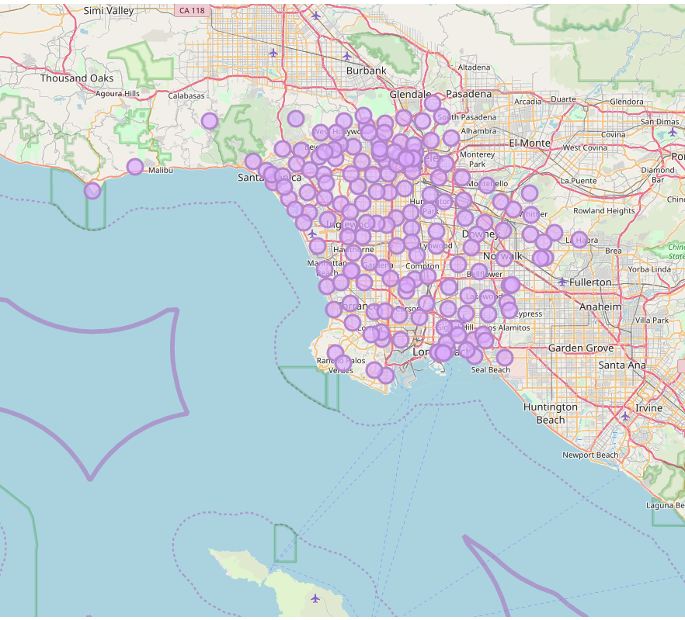
Map of LA Neighborhoods

Slide 8
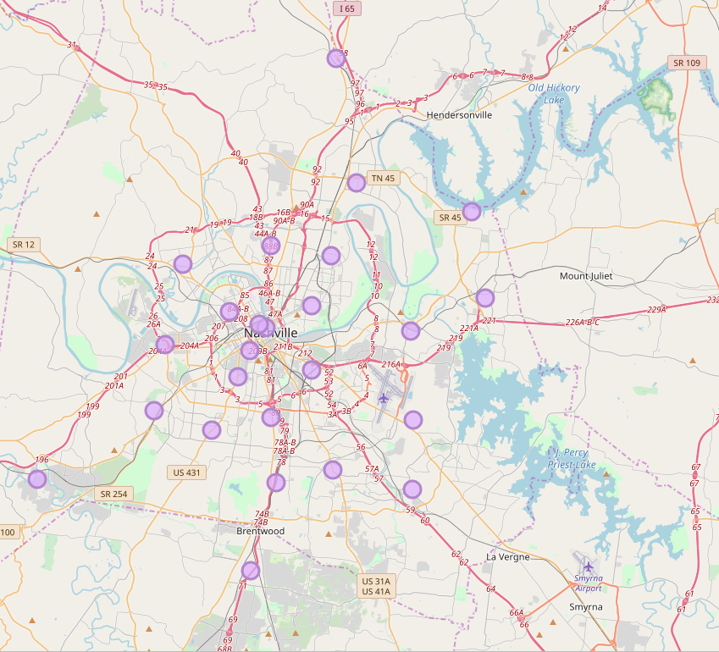
Map of Nashville Neighborhoods

Slide 9
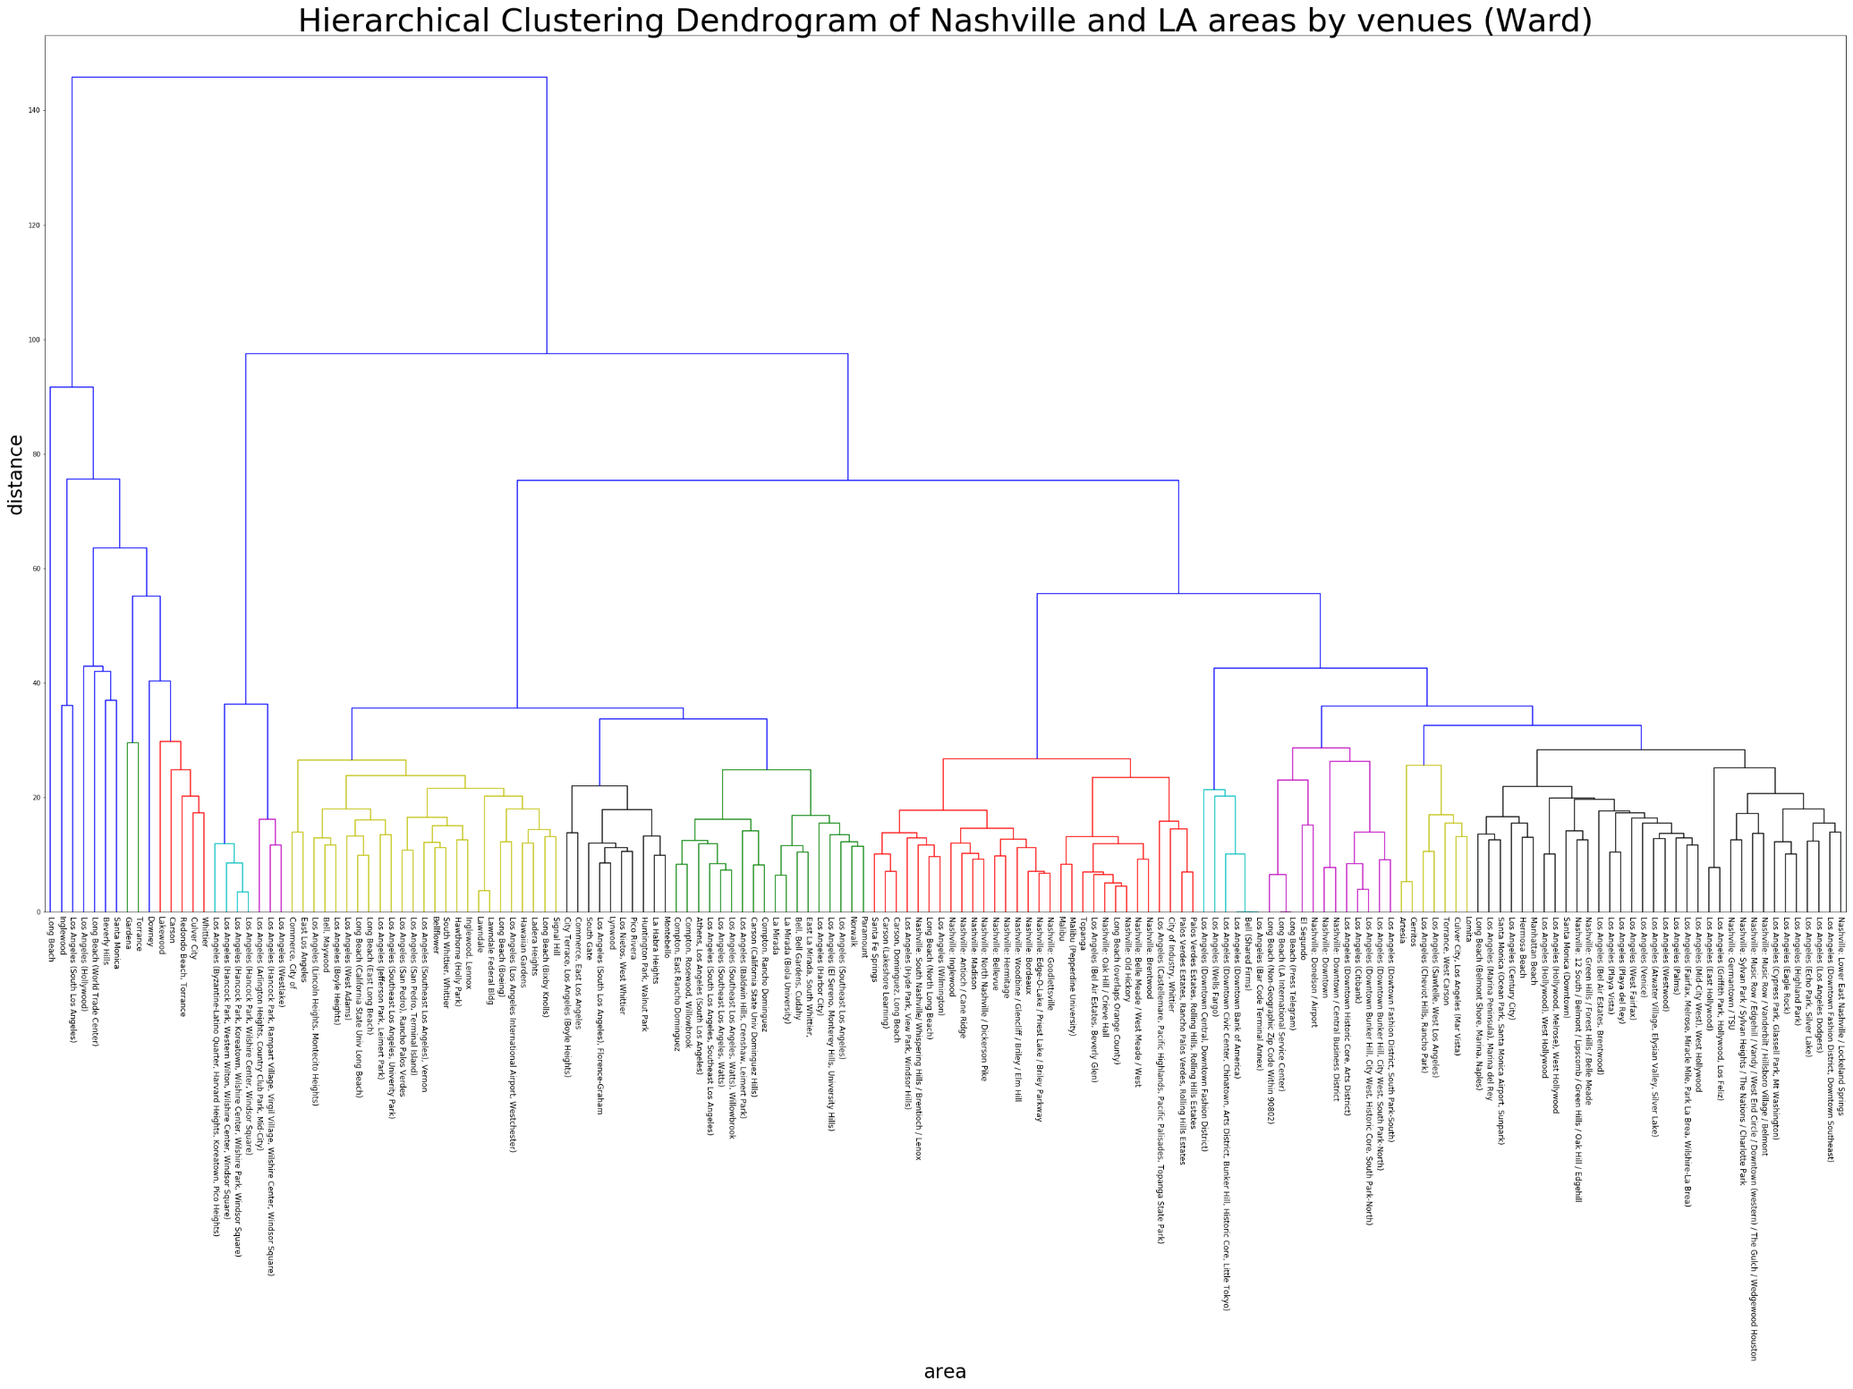
Dendrogram of LA and Nashville Neighborhoods
Zoom of dendrogram

Slide 10
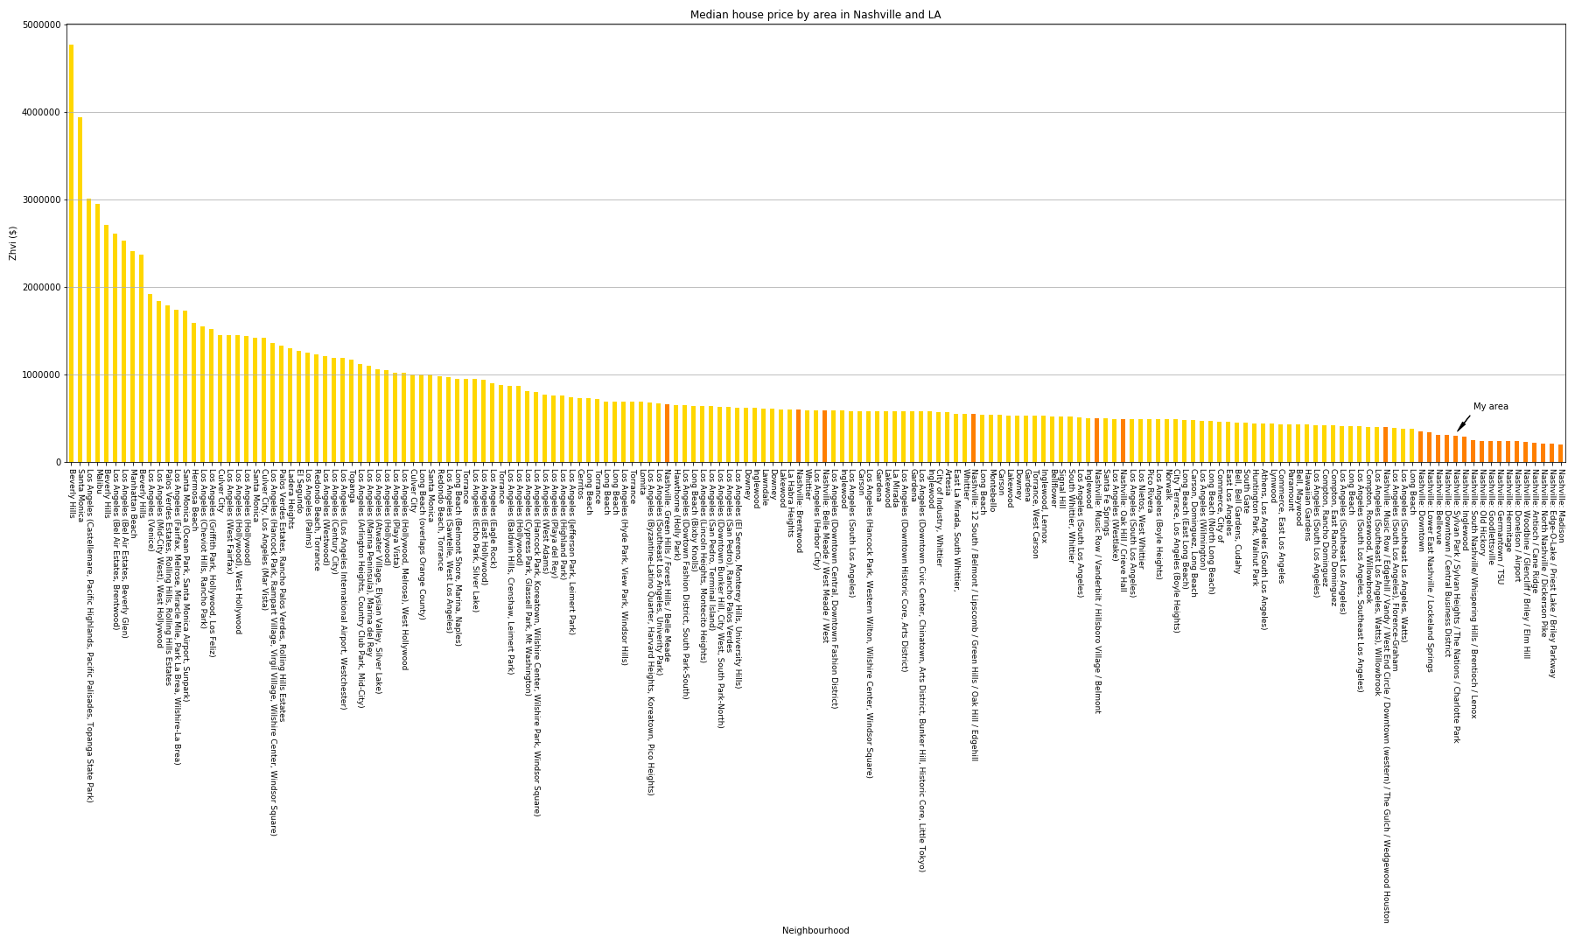
House price by neighborhood
Zoom of bar chart

Slide 11
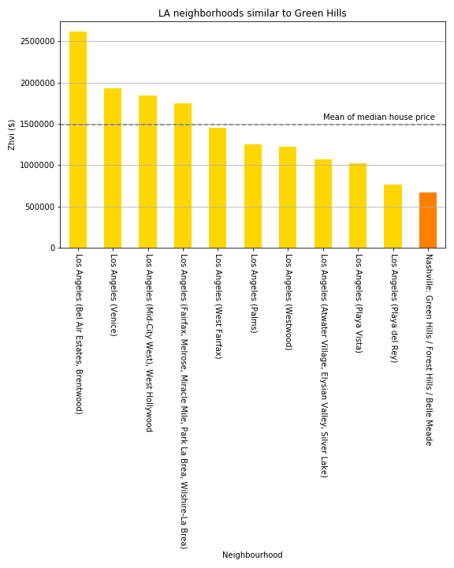
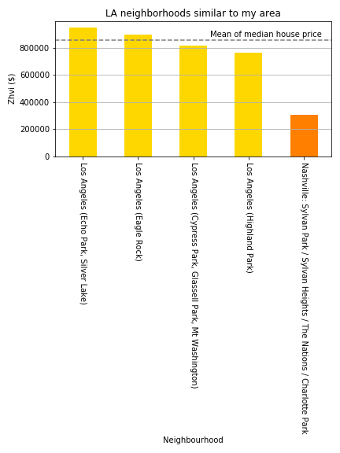
Case studies
*Mean for LA only

Slide 12
Areas where most common venue is hotel
Neighborhood | 1st Most Common Venue | 2nd Most Common Venue | 3rd Most Common Venue | 4th Most Common Venue | 5th Most Common Venue | 6th Most Common Venue | 7th Most Common Venue | 8th Most Common Venue | 9th Most Common Venue | 10th Most Common Venue
Beverly Hills | Hotel | Coffee Shop | American Restaurant | Boutique | Italian Restaurant | Park | Sushi Restaurant | Steakhouse | Cafe | Clothing Store
El Segundo | Hotel | Coffee Shop | Sandwich Place | Pizza Place | Airport Lounge | Airport Service | American Restaurant | Mexican Restaurant | Burger Joint | Beach
Los Angeles (Dowtown Fashion District, South Park-South) | Hotel | Coffee Shop | Bar | New American Restaurant | American Restaurant | Sushi Restaurant | Taco Place | Theater | Beer Bar | Mexican Restaurant
Los Angeles (Hollywood) | Hotel | Lounge | Pizza Place | Coffee Shop | Bar | Nightclub | Burger Joint | Gym | Mexican Restaurant | Music Venue
Los Angeles (Hollywood), West Hollywood | Hotel | Gym | Burger Joint | Vegetarian / Vegan Restaurant | Coffee Shop | Trail | Japanese Restaurant | Clothing Store | Comedy Club | Hotel Bar
Los Angeles (Hollywood, Melrose), West Hollywood | Hotel | Gym | Mexican Restaurant | Clothing Store | New American Restaurant | Burger Joint | French Restaurant | Cafe | Vegetarian / Vegan Restaurant | Sushi Restaurant
Nashville: Donelson / Airport | Hotel | Sandwich Place | Fast Food Restaurant | Pizza Place | Gas Station | American Restaurant | Mexican Restaurant | Automotive Shop | Pharmacy | Discount Store
Nashville: Music Row / Edgehill / Vandy / West End Circle / Downtown (western) / The Gulch / Wedgewood Houston | Hotel | Pizza Place | Music Venue | American Restaurant | Mexican Restaurant | Coffee Shop | Burger Joint | Taco Place | Sushi Restaurant | Bar

Slide 13
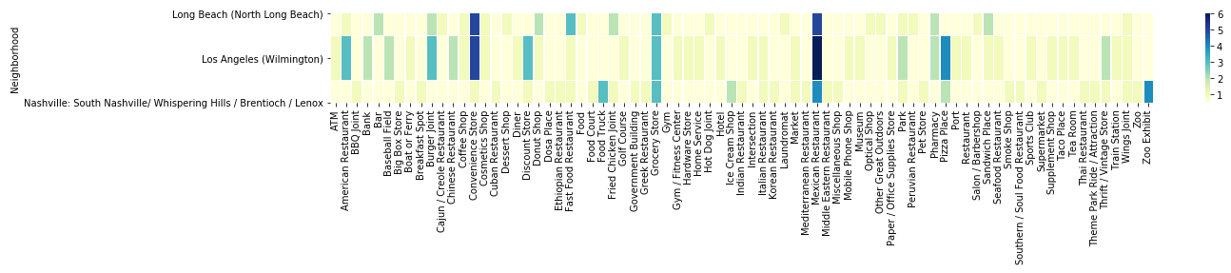
Heatmap of areas similar to South Nashville

Slide 14
Nashville music zones
Neighborhood | Venue | Venue Category
Downtown | Live On The Green Music Festival | Music Venue
Downtown | Bourbon Street Blues and Boogie Bar | Music Venue
Downtown | Ryman Auditorium | Music Venue
Downtown | Redneck Riviera | Music Venue
Downtown | The Stage on Broadway | Music Venue
Downtown | B.B. King's Blues Club | Music Venue
Downtown | Ascend Amphitheater | Music Venue
Music Row / Edgehill / Vandy / West End Circle / Downtown (western) / The Gulch / Wedgewood Houston | Music Row | Music Venue
Music Row / Edgehill / Vandy / West End Circle / Downtown (western) / The Gulch / Wedgewood Houston | The Station Inn | Music Venue
Music Row / Edgehill / Vandy / West End Circle / Downtown (western) / The Gulch / Wedgewood Houston | The High Watt | Music Venue
Music Row / Edgehill / Vandy / West End Circle / Downtown (western) / The Gulch / Wedgewood Houston | Exit/In | Music Venue
Music Row / Edgehill / Vandy / West End Circle / Downtown (western) / The Gulch / Wedgewood Houston | The Cannery Ballroom | Music Venue
Music Row / Edgehill / Vandy / West End Circle / Downtown (western) / The Gulch / Wedgewood Houston | Carter Vintage Guitars | Music Store
Music Row / Edgehill / Vandy / West End Circle / Downtown (western) / The Gulch / Wedgewood Houston | Ryman Auditorium | Music Venue
12 South / Belmont / Lipscomb / Green Hills / Oak Hill / Edgehill | Blackbird Studio | Music Venue
12 South / Belmont / Lipscomb / Green Hills / Oak Hill / Edgehill | Guitar Center | Music Store
12 South / Belmont / Lipscomb / Green Hills / Oak Hill / Edgehill | Corner Music | Music Store
12 South / Belmont / Lipscomb / Green Hills / Oak Hill / Edgehill | Fork's Drum Closet | Music Store
Music Row / Vanderbilt / Hillsboro Village / Belmont | Music Row | Music Venue
Music Row / Vanderbilt / Hillsboro Village / Belmont | Musicians Corner @ Centennial Park | Music Venue
Music Row / Vanderbilt / Hillsboro Village / Belmont | Exit/In | Music Venue
Downtown / Central Business District | Live On The Green Music Festival | Music Venue
Downtown / Central Business District | Bourbon Street Blues and Boogie Bar | Music Venue
Downtown / Central Business District | Ryman Auditorium | Music Venue
Downtown / Central Business District | The Stage on Broadway | Music Venue
Downtown / Central Business District | Redneck Riviera | Music Venue
Downtown / Central Business District | B.B. King's Blues Club | Music Venue

Slide 15
Conclusion
It is of course hard to parallel neighborhoods across cities to find their twin. And the sheer ratio of LA to Nashville neighborhoods (7:1) means there is more diversity in LA which is unmatched in Nashville.
Nevertheless, there are some neighborhoods that have a close degree of affinity, such as LA and Nashville’s downtowns, Green Hills and downtown Santa Monica, Lower East Nashville and the 90021 area.

Slide 16
Where should I move?
For music: Nashville’s Downtown areas, Music Row and 12 south
For traffic: ANYWHERE!
For affordability: Anywhere, except maybe these zip codes: 37215, 37027, 37205, 37204, 37212, 37220
For similarity: See dendrogram

Slide 17
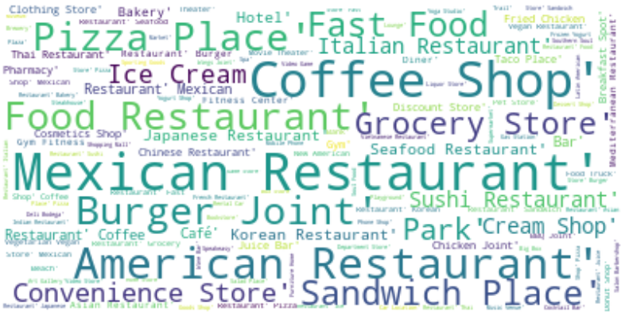
Bonus visual: LA venue word cloud

Slide 18
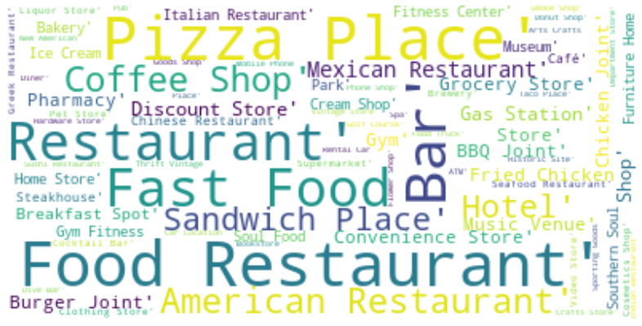
Bonus visual: Nashville venue word cloud

